Slide 1
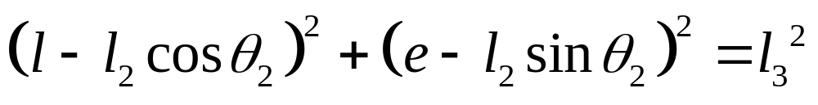
Limit Position Analysis of a RRRP Slider Crank Using Complex Numbers
Q
Im
l₅
θ₃
θ₃
θ₅
l₂
l₃
P
θ₂
e =l₄
Re
O
l=l₁
From position analysis we have

Slide 2
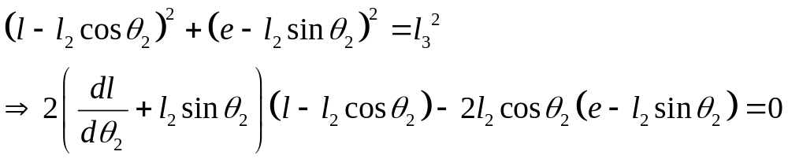
Limit Position Analysis of a RRRP Slider Crank Using Complex Numbers
Q
Im
l₅
θ₃
θ₃
θ₅
l₂
l₃
P
θ₂
e =l₄
Re
O
l=l₁
Differentiating

Slide 3
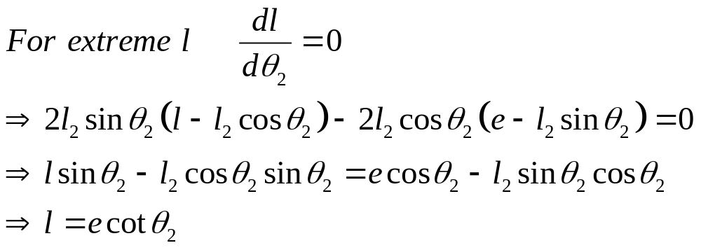
Limit Position Analysis of a RRRP Slider Crank Using Complex Numbers
Q
Im
l₅
θ₃
θ₃
θ₅
l₂
l₃
P
θ₂
e =l₄
Re
O
l=l₁
For extrema

Slide 4
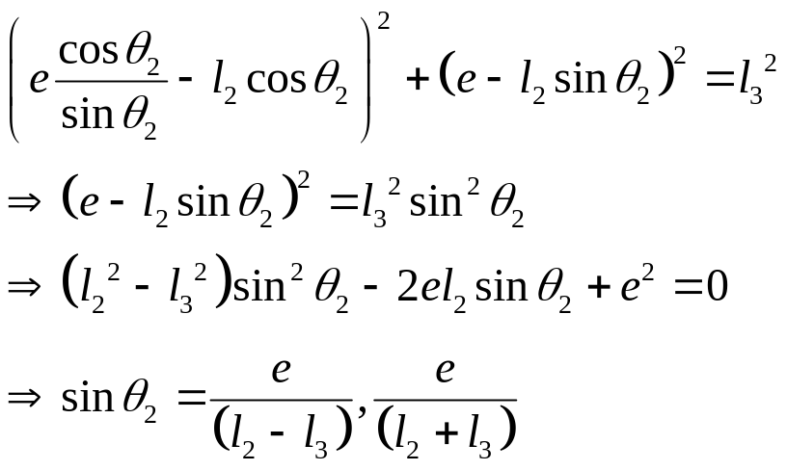
Limit Position Analysis of a RRRP Slider Crank Using Complex Numbers
Q
Im
l₅
θ₃
θ₃
θ₅
l₂
l₃
P
θ₂
e =l₄
Re
O
l=l₁
Substituting in original relation and solving for sin θ₂

Slide 5
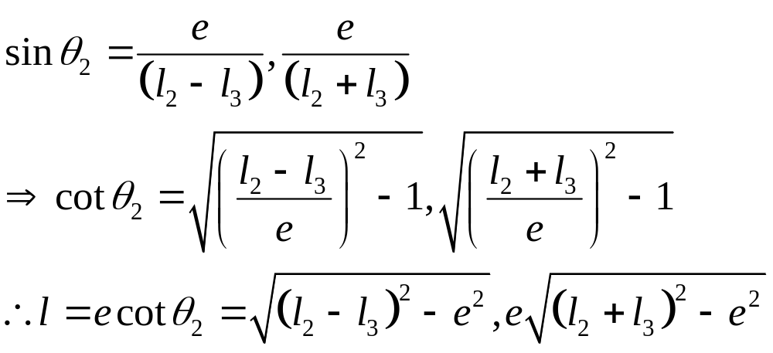
Limit Position Analysis of a RRRP Slider Crank Using Complex Numbers
Q
Im
l₅
θ₃
θ₃
θ₅
l₂
l₃
P
θ₂
e =l₄
Re
O
l=l₁
Solving for l

Slide 6
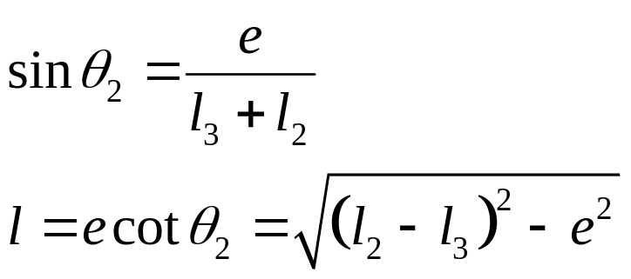
Limit Position Analysis of a RRRP Slider Crank Using Complex Numbers
Q
Im
l₅
θ₃
P
θ₅
l₃
l₂
θ₂=θ₃
e =l₄
O
l
Re
l=l₁
One extreme configuration

Slide 7
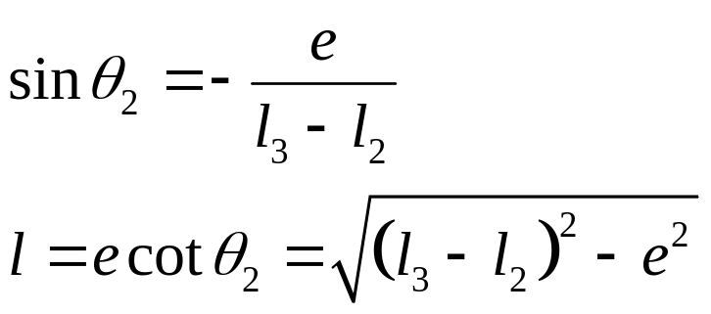
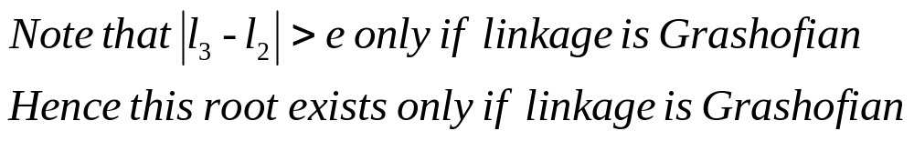
Limit Position Analysis of a RRRP Slider Crank Using Complex Numbers
Im
P
θ₂=θ₃
e =l₄
Re
θ₂
O
l=l₁
l₃
l₂
Q
θ₃
l₅
θ₅
θ₃
Another extreme configuration

